Slide 1
Lean
With
MEAN

Slide 2



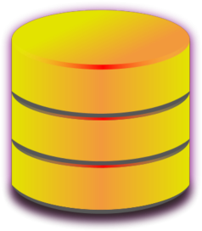




JSON
JSON
JSON
JSON
Collection of JavaScript based technologies used to develop web applications.

Slide 3


MEAN.JS – Timeline
Mean.io created by Linnovate
Apr 2013
May 2013
Feb 2014
Valeri Karpov coined the term “MEAN stack” on his blog.
Amos Haviv leaves Linnovate and creates Meanjs.org
Stanford University
http://blog.mongodb.org/post/49262866911/the-mean-stack-mongodb-expressjs-angularjs-and

Slide 4
What is
MEAN.JS is a full-stack JavaScript solution that helps you build fast, robust, and maintainable production web applications using MongoDB, Express, AngularJS, and Node.js.
MEAN.JS helps to get started and avoid useless grunt work and common pitfalls, while keeping the application organized.

Slide 5


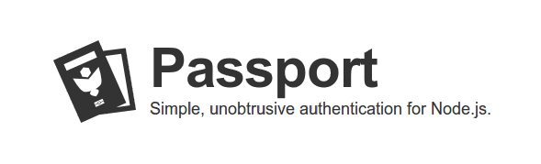



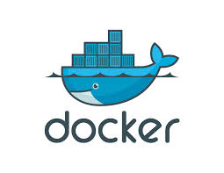





ECOSYSTEM

Slide 6
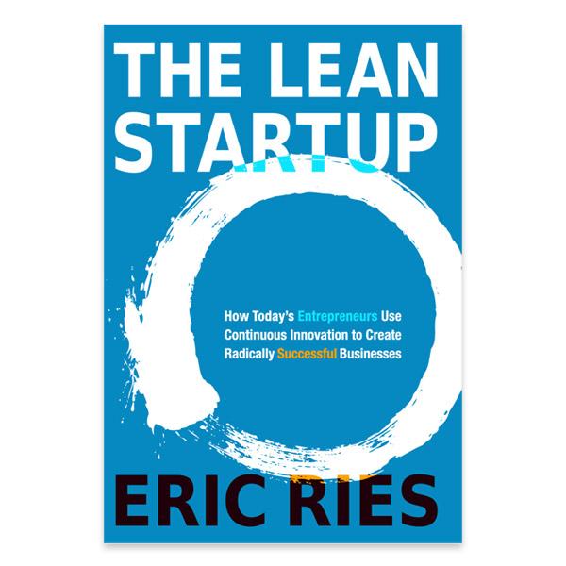
LEAN STARTUP

Slide 7
Lean Startup
Ideas
Build
Code
Measure
Data
Learn
Minimize total time through the loop

Slide 8
Typical Lifecycle of Lean startups and how MEAN fits in

Slide 9
Lean Startup Lifecycle
Problem Solution Fit
Product Market Fit
Growth Hacking

Slide 10
Example - Restaurant Discovery
Startup which helps people discover great restaurants

Slide 11
Stage 1- Problem/Solution Fit
Solution
Problem
Customer

Slide 12
Starting Out
Stage 1
Uncertainty
Inability to commit resources
Need to release quickly and get buy-in from customers

Slide 13
Define MVP
Stage 1
Build a Restaurant rating and discovery web app
Logged in users can add restaurants
Logged in users can rate restaurants
Users can search for restaurants by rating
Get started with 1 full stack JS developer

Slide 14
Get started MEAN stack
Stage 1
Use generators to generate basic code structures for business objects
Install Yeoman
Install MEANjs generator
Generate MEAN stack
$ sudo npm install -g yo
$ sudo npm install install -g generator-meanjs
$ yo meanjs

Slide 15
Add Business Objects
Stage 1
Add model definition and basic operations (CRUD) for Restaurant
$ yo meanjs:crud-module restaurant
Add fields to model
$ edit app\models\restaurant.server.model.js
Add Business Logic by editing controllers
$ edit app\controllers\restaurant.server.controller.js
$ edit public\modules\cities\controllers\restaurant.client.controller.js

Slide 16
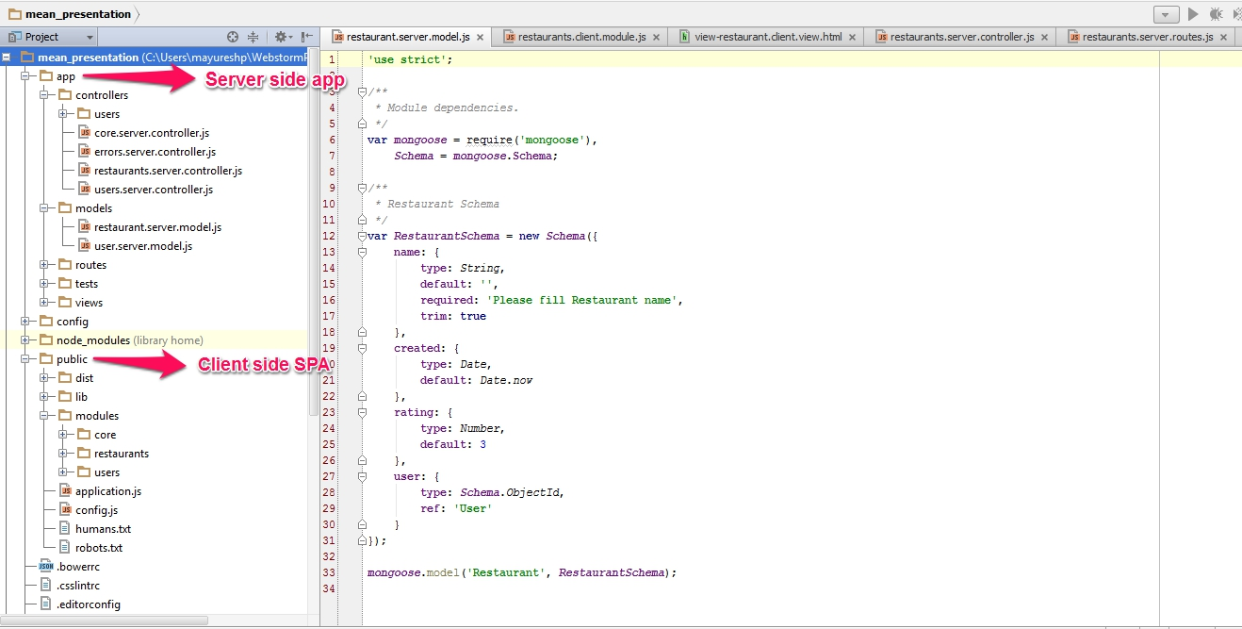
Generated Code
Stage 1

Slide 17
Run Demo
Stage 1
Make changes to the home screen
Run MongoDB
Run server
View the website at
$ edit public\modules\core\views\home.client.view.html
$ sudo mongod
$ grunt
http://localhost:3000/

Slide 18
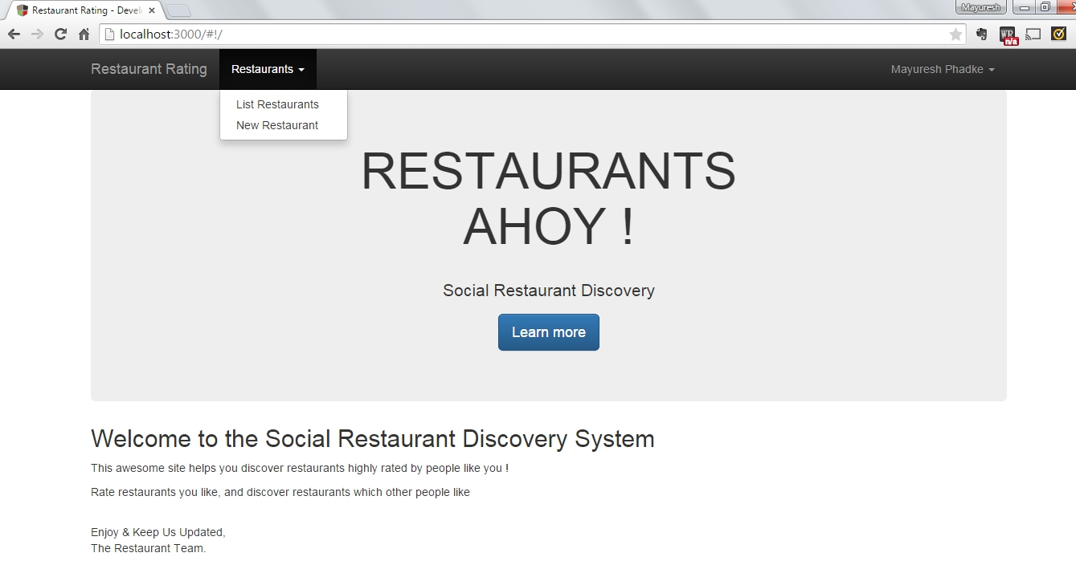
Initial Demo
Stage 1
http://localhost:3000/

Slide 19
Initial Demo
Stage 1
Quickly have
A running demo
Which is responsive
With user signup and Authentication
Use the demo to validate the problem solution fit
Solution
Problem
Customer

Slide 20

Stage 2 – Product Market Fit
Do metrics based quantitative research by exposing a minimum viable product to determine a set of features that delivers value to a set of customers
Change product features depending on customer feedback and take the modified product to customers quickly

Slide 21
Build Iteratively
Stage 2
Ideas
Build
Code
Measure
Data
Learn

Slide 22
Changes from Feedback
Stage 2
Customers like the concept
Users want to discover restaurants in close vicinity
Feedback from demos indicate that geo-location should be added to restaurants, to be able to find nearest restaurants

Slide 23
Change Business Objects and Logic
Stage 2
Add fields to model
$ edit app\models\restaurant.server.model.js
Add business logic by editing controllers
$ edit app\controllers\restaurant.server.controller.js
$ edit public\modules\cities\controllers\restaurant.client.controller.js
Mongo DB is schema-less, hence changing the models is possible without DB migration
Changes to models are very easy

Slide 24
Changes from Feedback
Stage 2
Geolocation could be easily added
The business logic around geolocation is updated
The time and effort to integrate feedback and to iterate through the Build – Demo – Feedback loop is minimal

Slide 25

Iterate
Stage 2
Keep building new features
Change features
Remove unrequired
Get to a set of features
which deliver value
to a set of customers

Slide 26
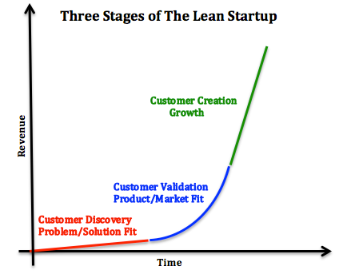
Stage 3 - Growth
Minimize total time through the loop

Slide 27
Readying for Growth
Stage 3
Once a product market fit is achieved, the aim would be to grow the customer base through various means
Growing the customer base means the tech stack needs to be ready to handle the growth
This includes automated tests, continuous integration, easy deployments, and scaling the server

Slide 28
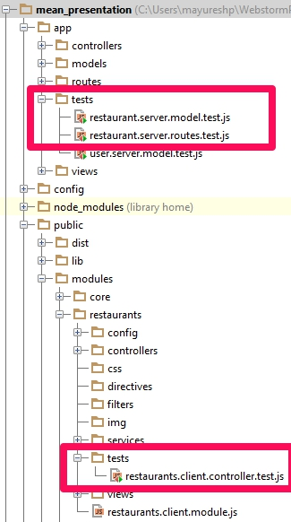
Automated Tests
Stage 3
Mocha is used to test server side logic. Mocha tests are asynchronous, easy to maintain, and uses a readable BDD syntax
Karma test runner is used to run client side tests on various browsers. Jasmine framework is used to write the tests.

Slide 29
Continuous Integration
Stage 3
A starter .travis.yml file is provided which helps to get started with integrating with Travis
Travis integration provides a great way to test each check-in, and also allows developers to test each pull request before merge

Slide 30
Deployment
Stage 3
Meanjs provides starter files to deploy on
Docker – Dockerfile, fig.yml
Heroku – Procfile
These can be used to deploy on a public facing server, enabling to get to customers faster

Slide 31
Code Maintainability
Stage 3
As the code base grows, separation of concerns between functionality as follows
Client
Controllers
Services
Server
Models
Controllers
allows different set of developers to work on separate directories and allows parallel development.

Slide 32
Scaling the server
Stage 3
Node.js provides asynchronous, non-blocking I/O. This allows node to serve a large number of simultaneous requests to the server
MongoDB is proven to scale for large size of data as well as large number of I/O operations
Both these technologies help the MEAN stack to scale with the user growth

Slide 33
MEAN Drawbacks
Opinionated stack – directory structure and technology choices are pre-decided.
If any component is changed, the advantage of auto-generating code and using the standard config files is lost.
Server side code in Node.js can become very complex if not written properly leading to callback hell.

Slide 34
Lean with MEAN
Restaurant discovery startup using Lean principles went through the stages from conception to Growth utilizing the MEAN stack
Code generators make it easy to start writing code
CI and tests make sure the incremental changes do not break functionality
Heroku/Docker allows easy deployments to get changes to customers faster
Node.js helps scaling
Mongo allows quick changes to schemas and supports data at scale

Slide 35
Lean with MEAN
MEAN stack is a good candidate as a tech stack for a Lean startup

Slide 36
Q & A

Slide 37

www.synerzip.com
Hemant Elhence
hemant@synerzip.com
469.374.0500
37
84

Slide 38
Synerzip in a Nutshell
Software product development partner for small/mid-sized technology companies
Exclusive focus on small/mid-sized technology companies, typically venture-backed companies in growth phase
By definition, all Synerzip work is the IP of its respective clients
Deep experience in full SDLC – design, dev, QA/testing, deployment
Dedicated team of high caliber software professionals for each client
Seamlessly extends client’s local team, offering full transparency
Stable teams with very low turn-over
NOT just “staff augmentation”, but provide full mgmt support
Actually reduces risk of development/delivery
Experienced team - uses appropriate level of engineering discipline
Practices Agile development – responsive, yet disciplined
Reduces cost – dual-shore team, 50% cost advantage
Offers long term flexibility – allows (facilitates) taking offshore team captive – aka “BOT” option

Slide 39



























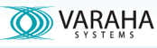














Our Clients
Notes:
39
39

